Slide 1
Display Bookshelves
Hackathon Presentation – Team 3
Cohort Code : QEA21QE021

Slide 2
Hackathon Team
S.No | Employee Name | Employee ID
1 | Parshyam Nagaveni | 918628
2 | Chandra Kavya | 919339
3 | Shravika Ingole | 918890
4 | Gintena Saitharun Goud | 919352
5 | Vunnam Gowtham | 918630

Slide 3
Project Description
Display the name & price of first 3 Bookshelves below Rs. 15000, with Storage type as open & exclude out of stock
From Collections, retrieve all sub-menu items under Being-At-home and store in a List; Display the same
Gift cards - choose "Birthday/Anniversary"; fill customize the gift card; fill from to details with any one input invalid (example: email); Capture & display the error message

Slide 4
Tools, Software, Website Used
Website : https://www.urbanladder.com/
Selenium : Portable Framework for testing web applications and automating the process.
Java : High level programming language.
Eclipse : Integrated Development environment for various Programming Languages.
TestNG : Open source testing framework.
Maven : Software and project management tool.
POM : Object Repository design pattern.
Jenkins : An open source automation server for continuous integration.

Slide 5
Work Done
The code is written in JAVA language and then it is further automated using selenium.
Page Object Model(POM) is used to reduce the code duplication for various instances.
Input data is taken from excel file using Apache POI.
Output data is printed in a excel file .
Jenkins repositories are also used, so as to make it easy to make changes to various versions of code and to modularize it; also to help with continuous integration.

Slide 6
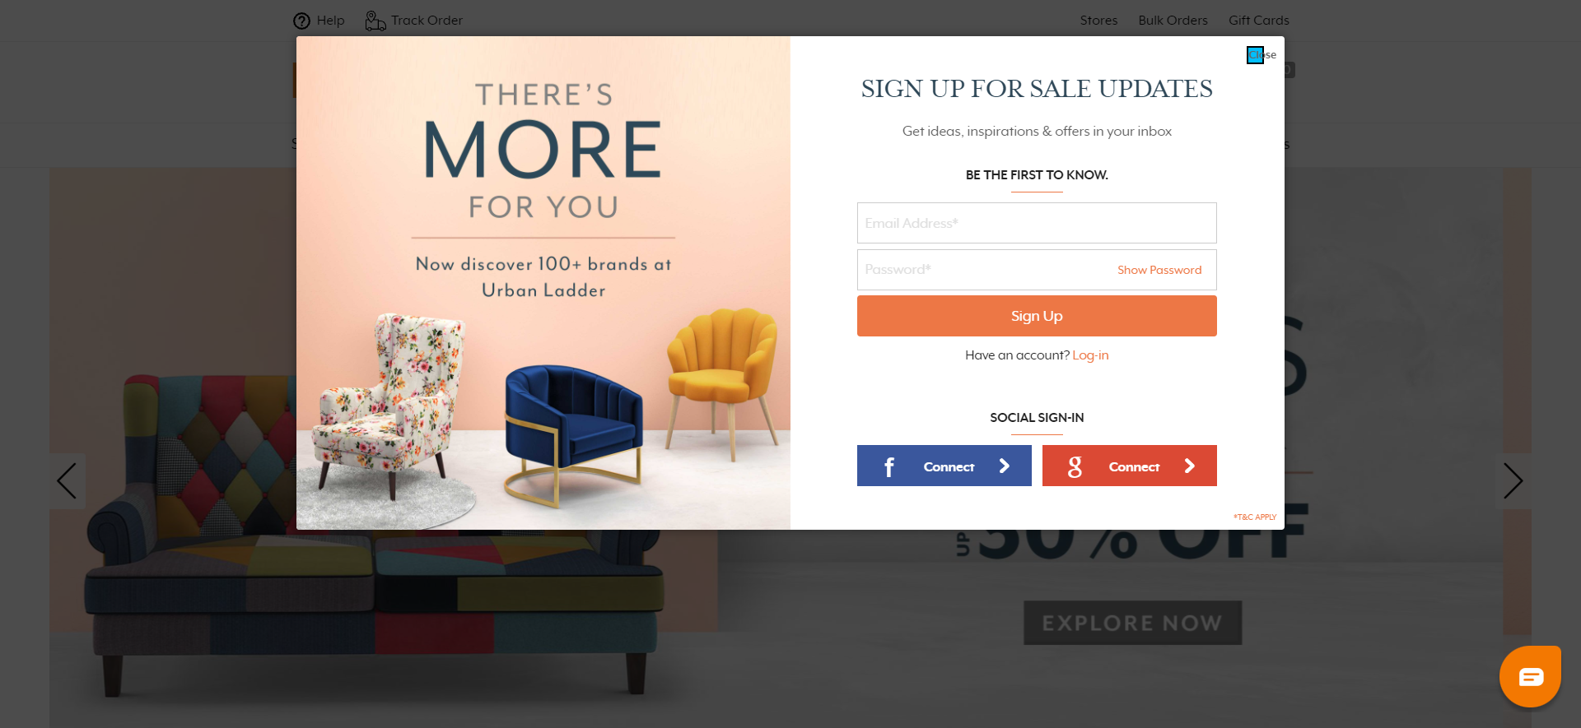
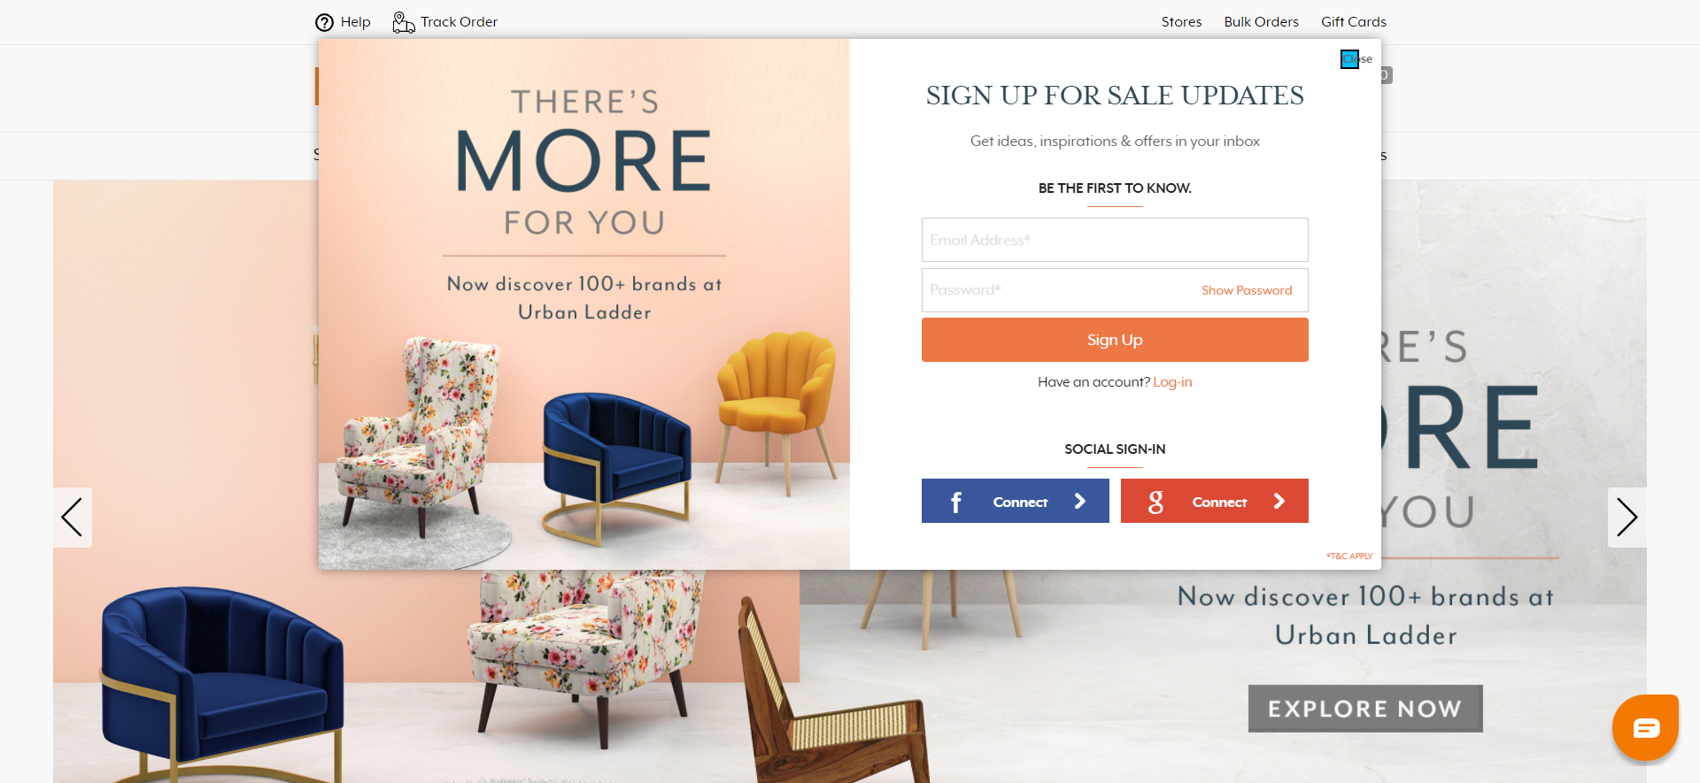
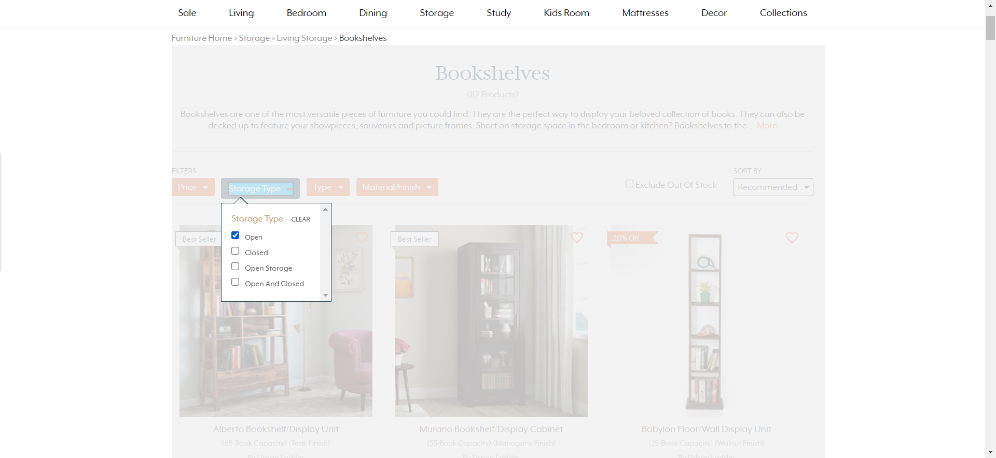
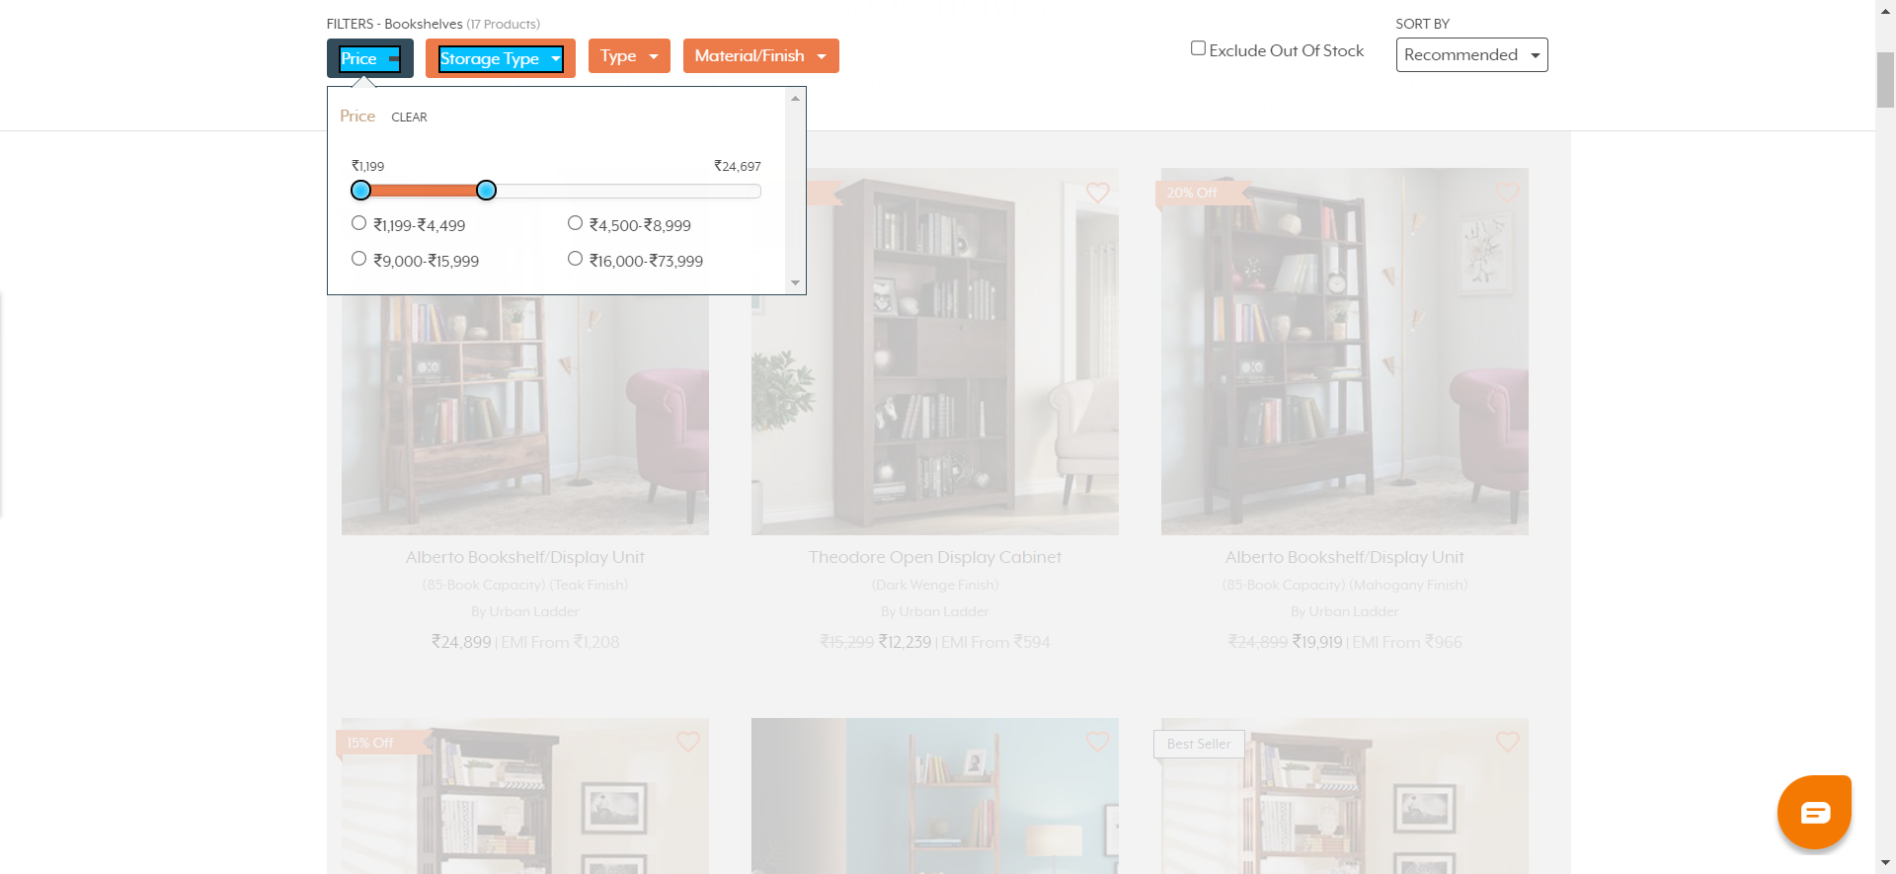
Screenshots of Output

Slide 7
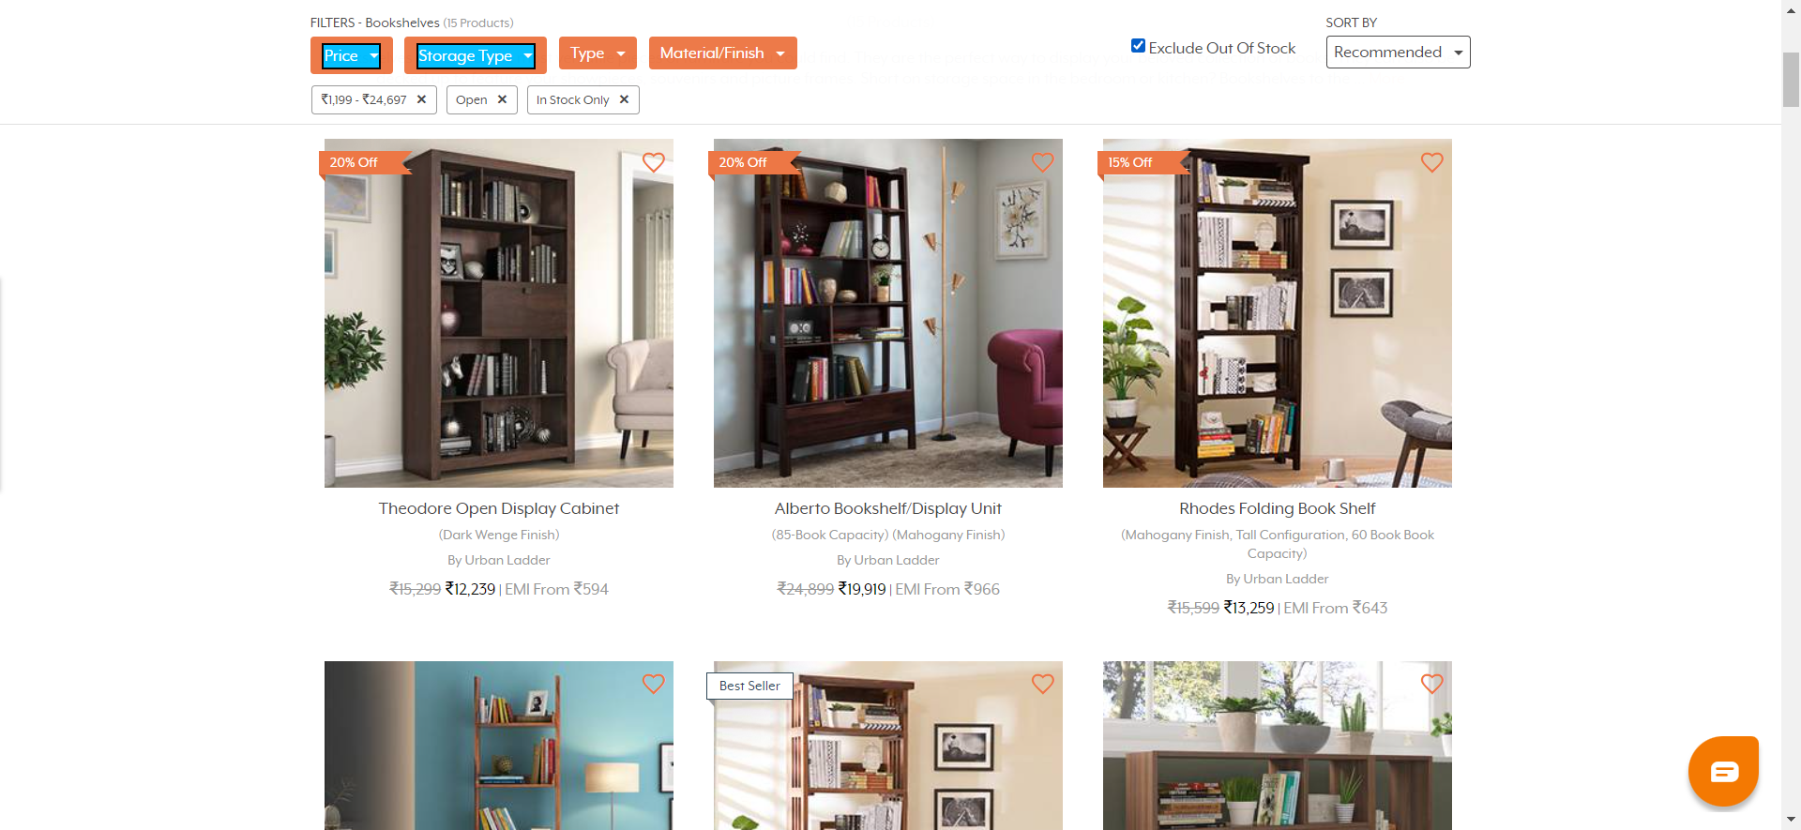
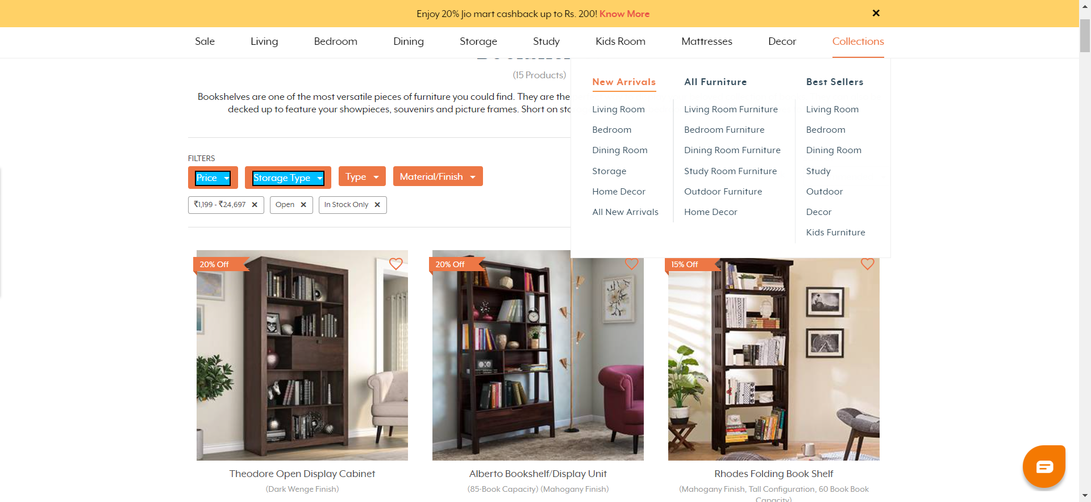
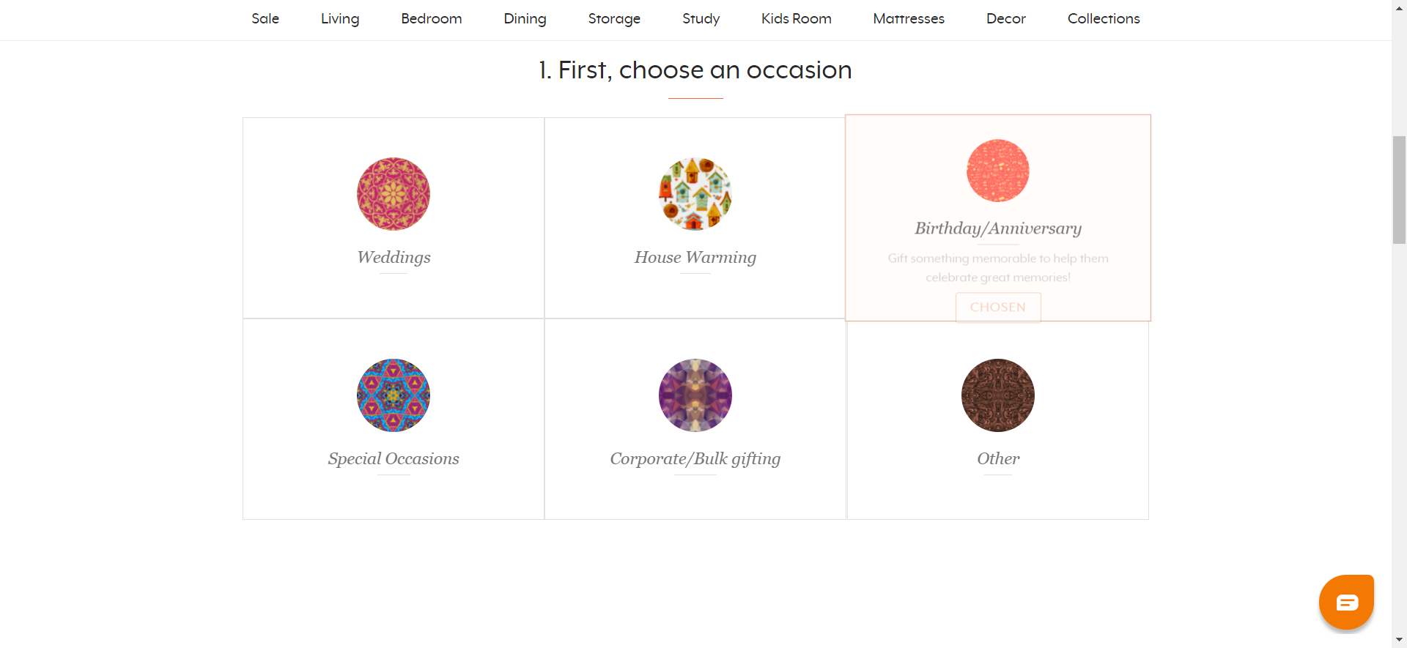
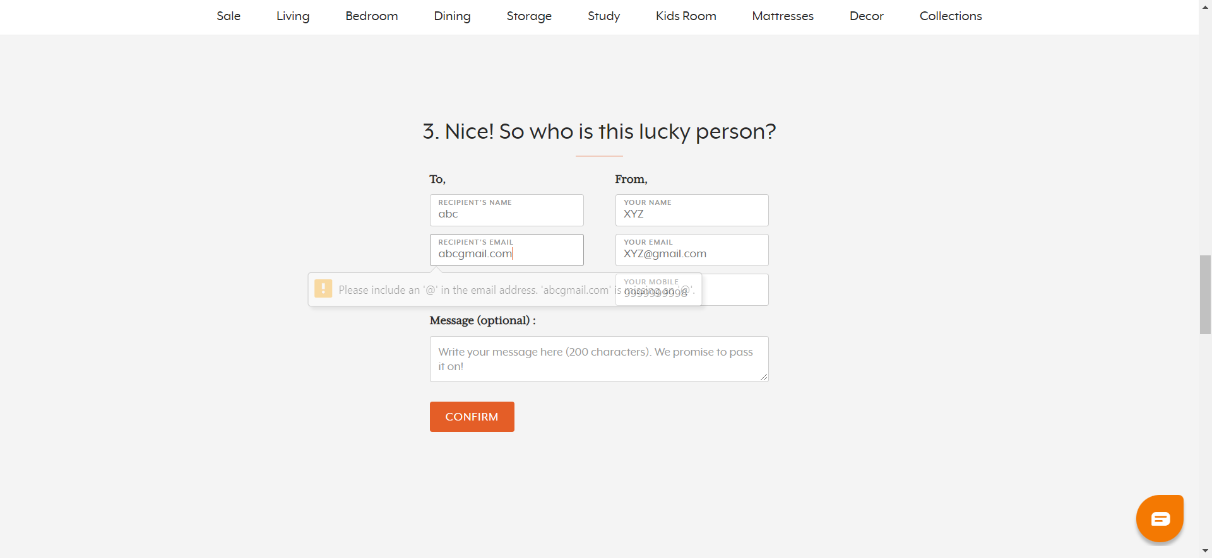
Screenshots of Output

Slide 8
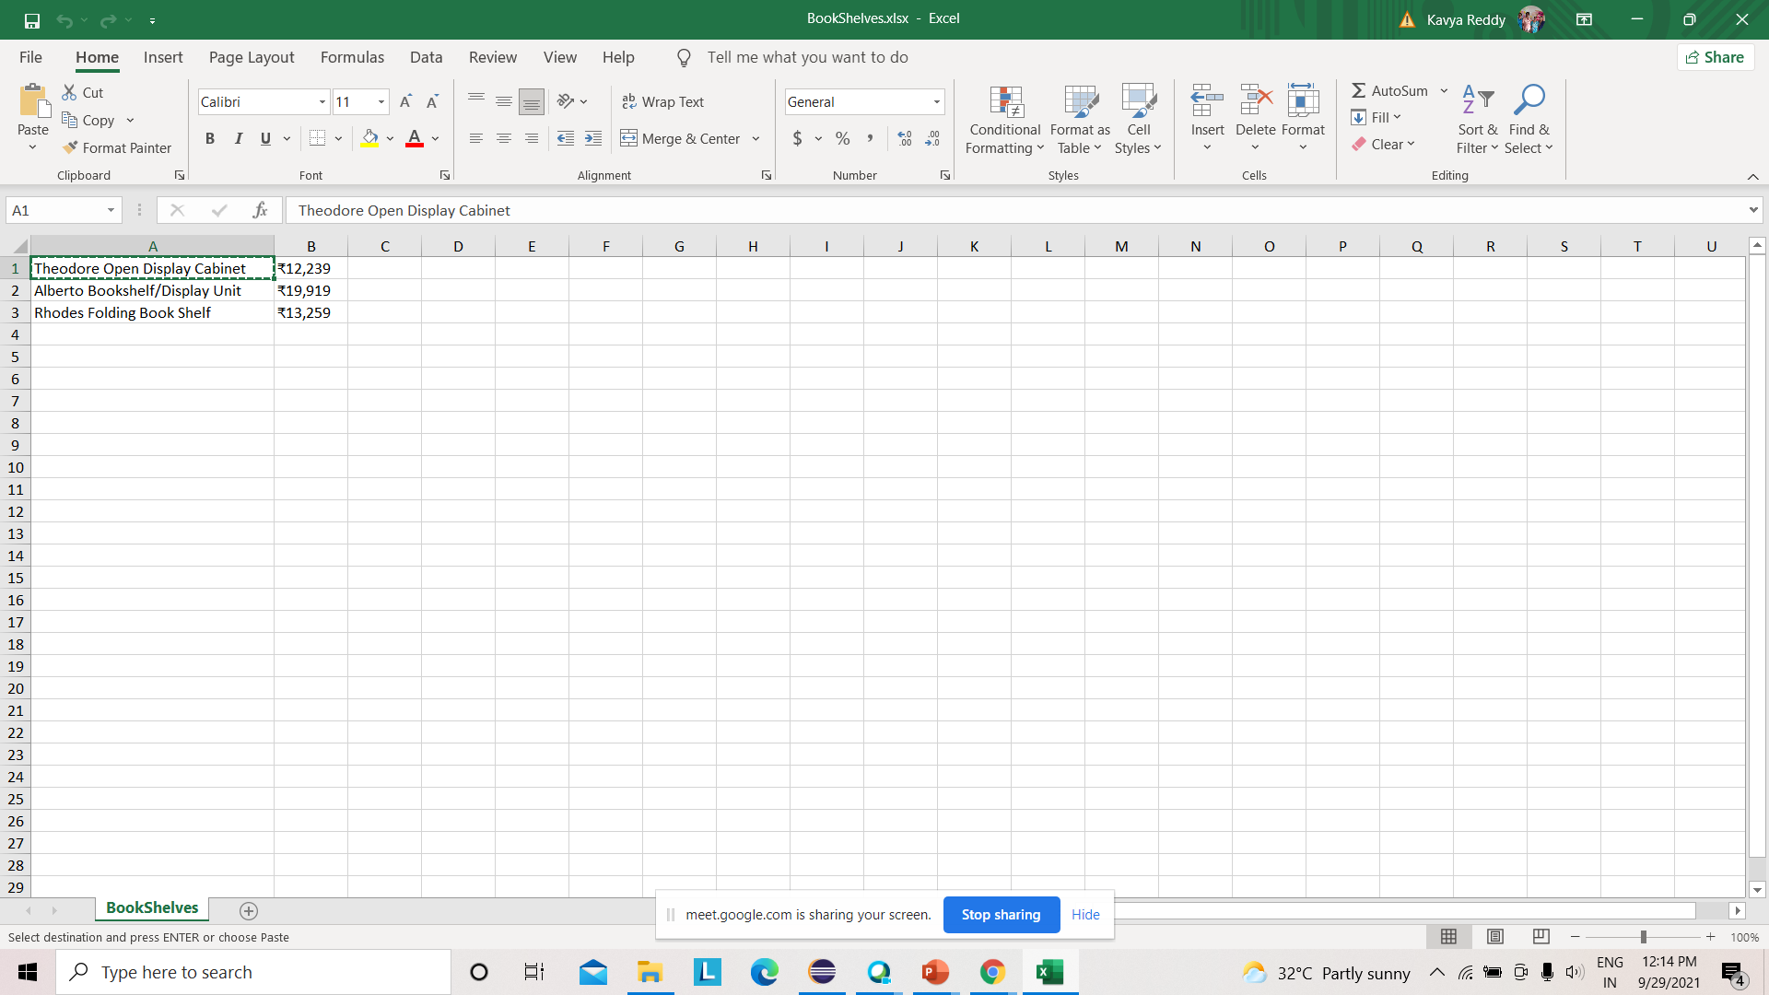
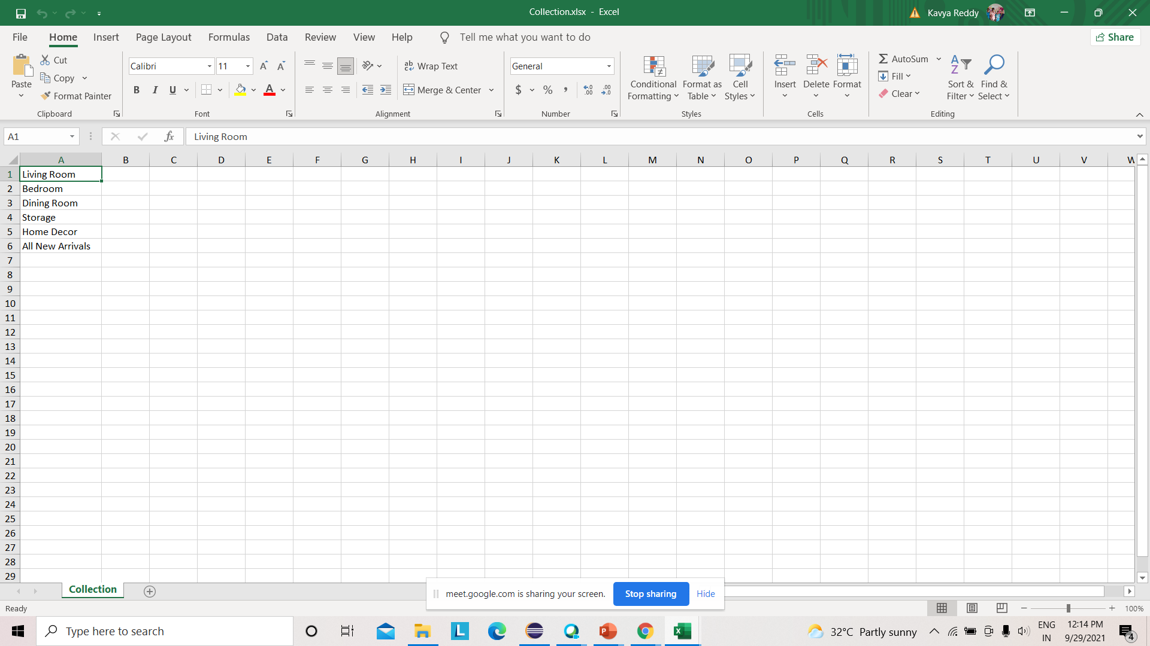
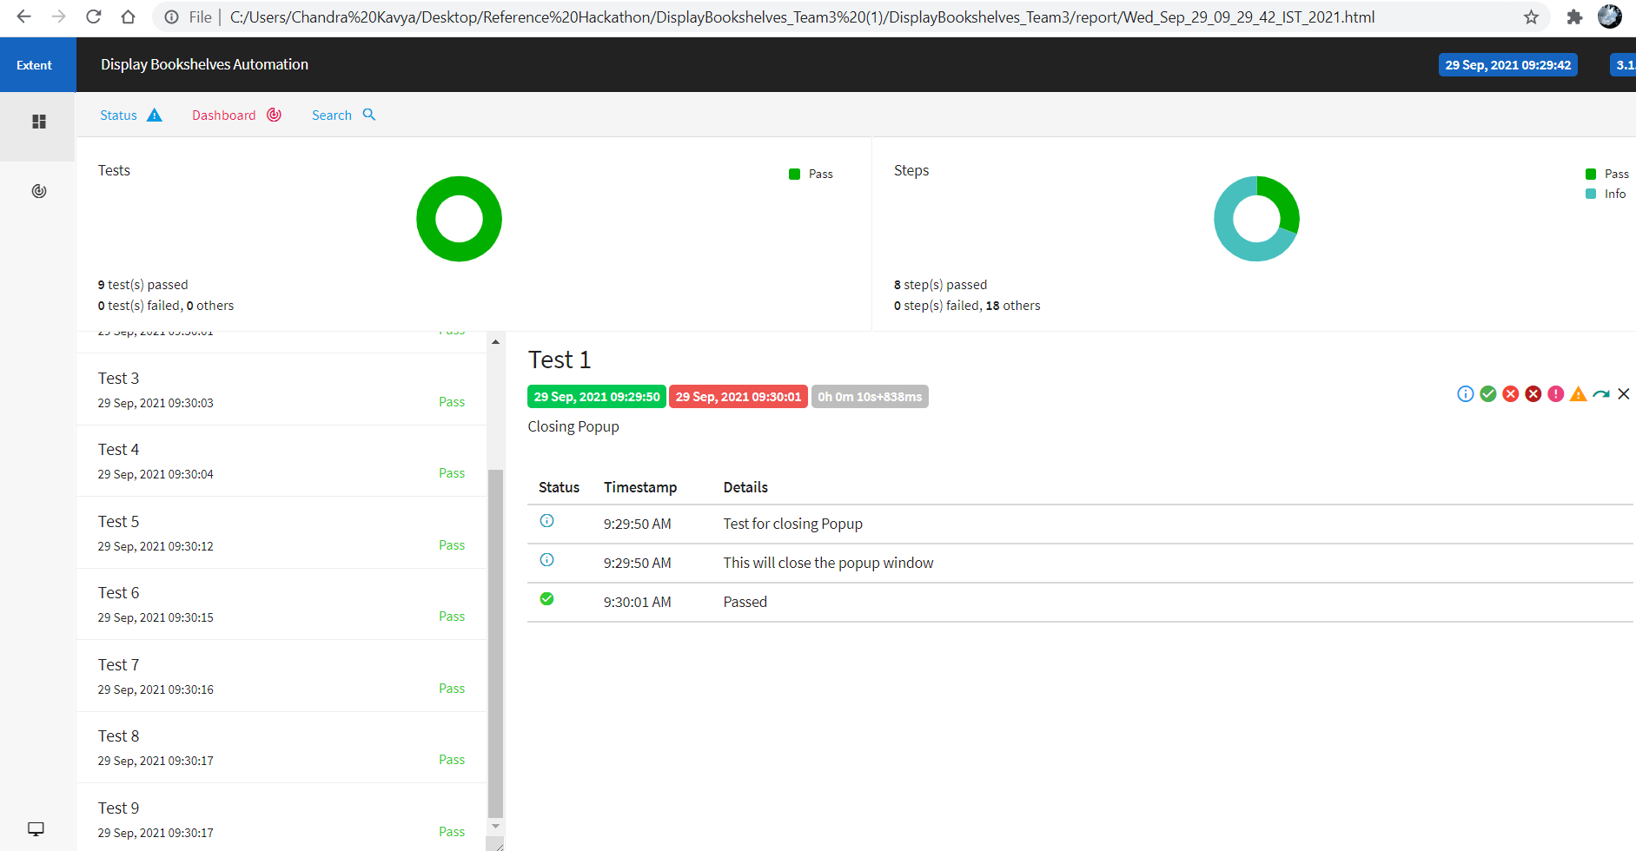
Excel Sheet and Report Screenshots

Slide 9
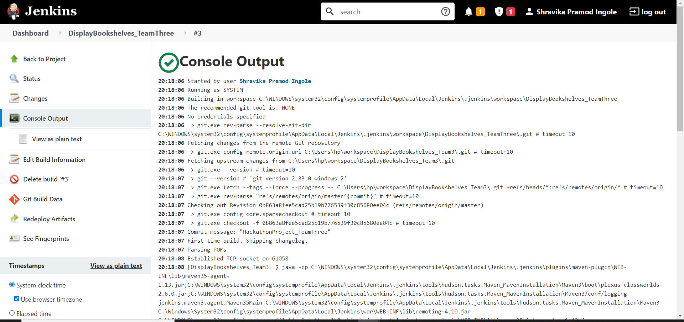
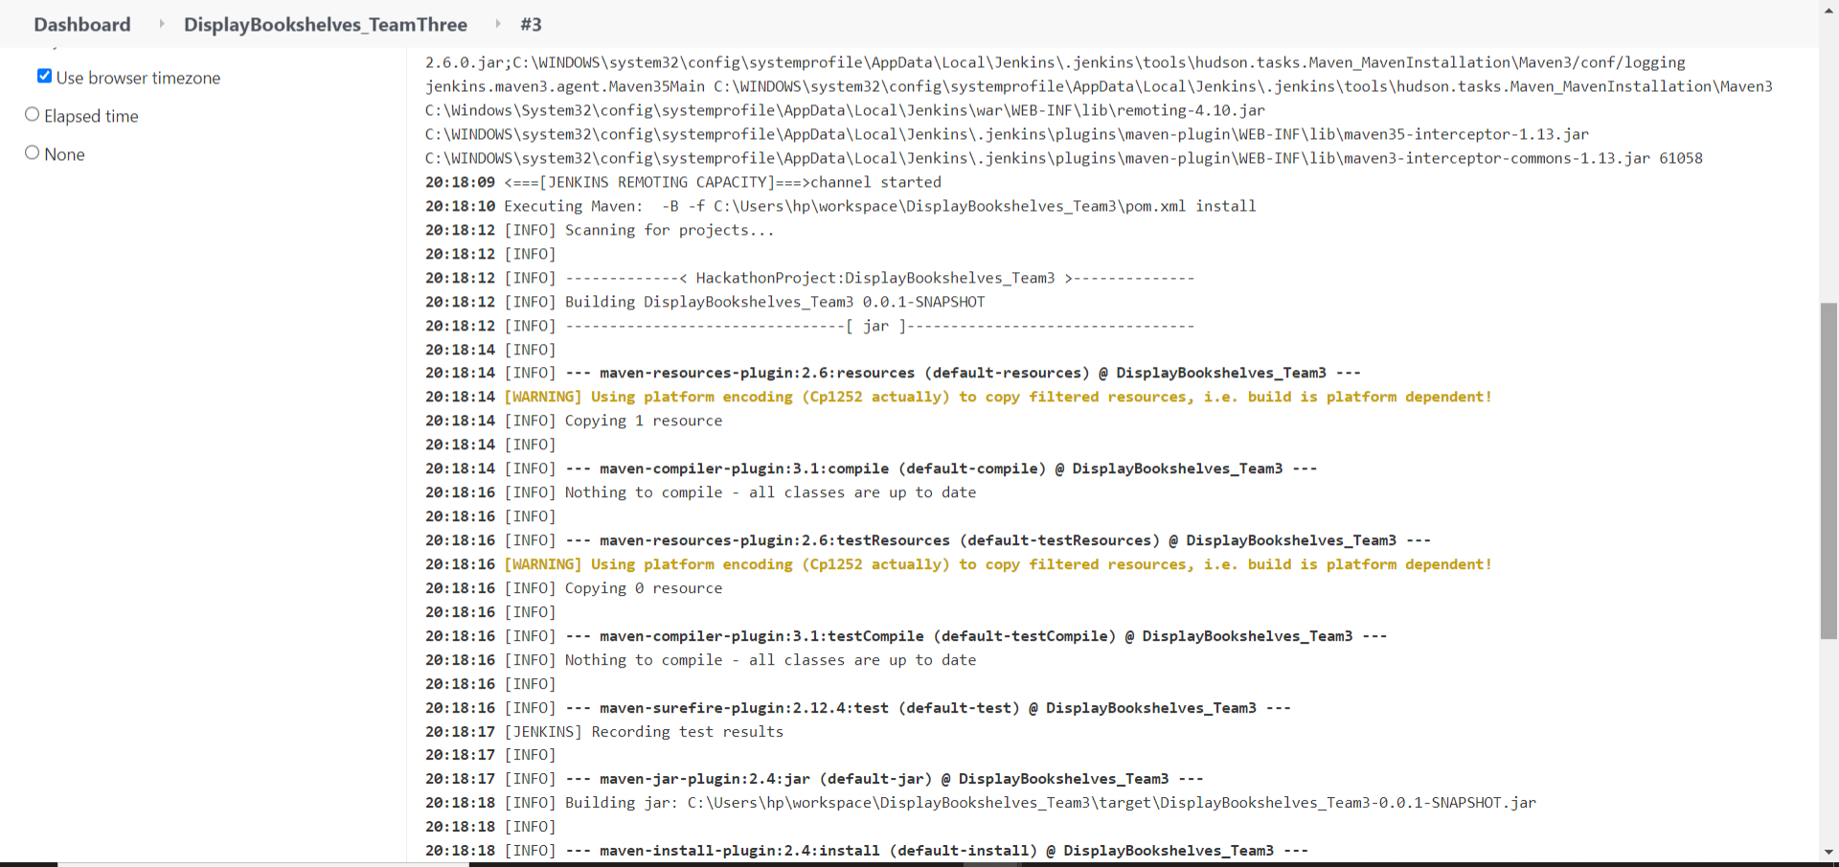
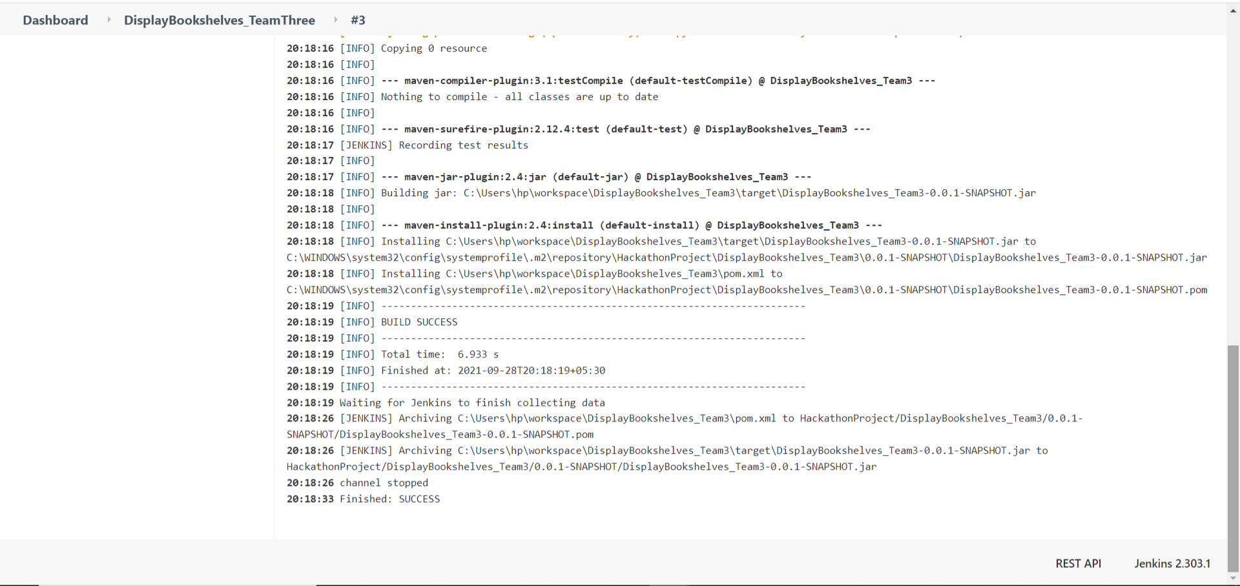
Jenkins Screenshots

Slide 10
Thank You

